Slide 1
IoT Based Home Automation
IoT stands for Internet of Things
The Internet of Things refers to the ever-growing network of physical objects that feature the communication between these objects and other Internet-enabled devices or systems.

Slide 2
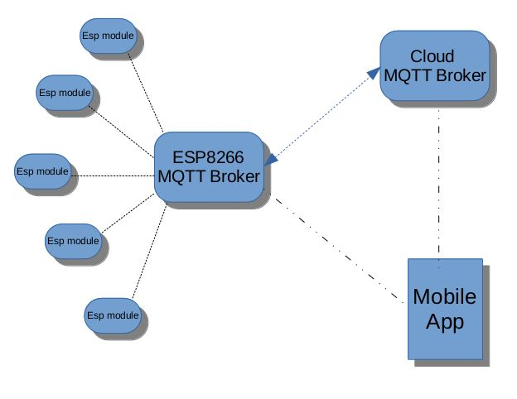
IoT Based Home Automation

Slide 3
IoT Based Home Automation
MQTT
MQTT (Message Queuing Telemetry Transport) is a lightweight messaging protocol that provides resource-constrained network clients with a simple way to distribute information.
It is used for machine-to-machine (M2M) communication and plays an important role in IoT.

Slide 4
IoT Based Home Automation
MQTT Broker is at the heart of any publish / subscribe protocol and can handle thousands of concurrent connected MQTT clients and also responsible for receiving all messages, filtering the messages, determining who is subscribed to each message, and sending the message to these subscribed clients.
Another responsibility of the broker is the authentication and authorization of clients. Examples are m11.cloudmqtt.com, io.adafruit.com etc.

Slide 5
IoT Based Home Automation
The MQTT connection is always between one client and the broker. Clients never connect to each other directly. To initiate a connection, the client sends a CONNECT message to the broker. The broker responds with a CONNACK message and a status code. Once the connection is established, the broker keeps it open until the client sends a disconnect command or the connection breaks.

Slide 6
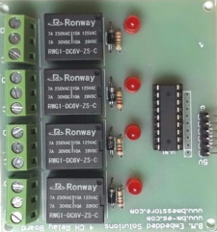
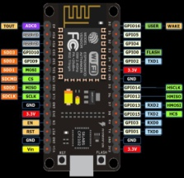
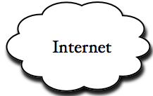


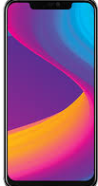

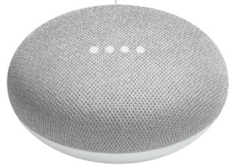
IoT Based Home Automation
Voice Instructions and Data Flow

Slide 7
IoT Based Home Automation
Requirements
Hardware
NodeMCU with Wi-Fi Module (ESP 8266)
Relay Board
Power Supply
(B) Accounts
1. On io.adafruit.com
2. On IFTTT.com
(C) Software
Arduino IDE

Slide 8
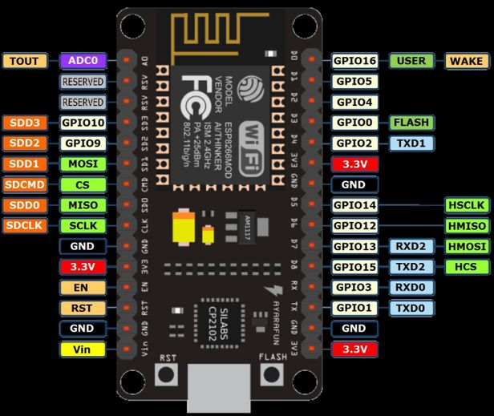
IoT Based Home Automation
NodeMCU
Specifications :
CUP – 8266
Memory – 128kBytes
Storage – 4MB
Volts – 3/5V
GPIO – 10
Pros :
1. Integrated Wi-Fi
2. Low Power
3. Small in Size
Cons :
1. Less Pin-outs

Slide 9
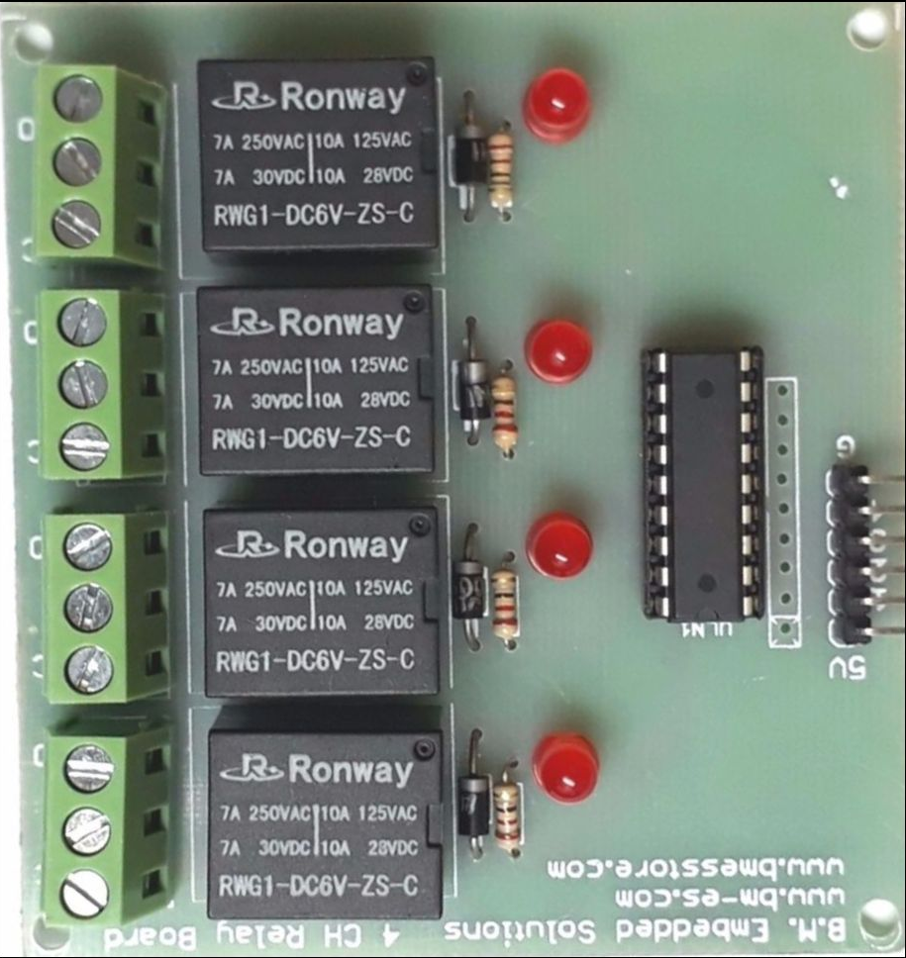
IoT Based Home Automation
Relay-Board
Specification :
Controller – ULN2803
Voltage – 5 V
Relay – 250V 7A
No of Relay – 4
Operations – 3/5 V Directly from microcontroller.

Slide 10
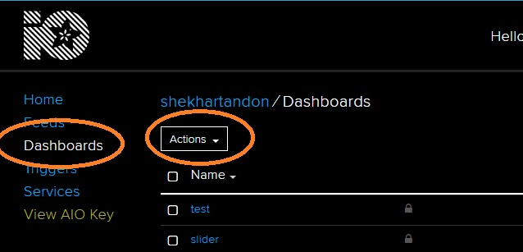
IoT Based Home Automation
Accounts on io.adafruit.com
The site works as broker you need to create your account on the site to create a secure connection between NodeMCU and Broker.
After login create your DASHBOARD

Slide 11
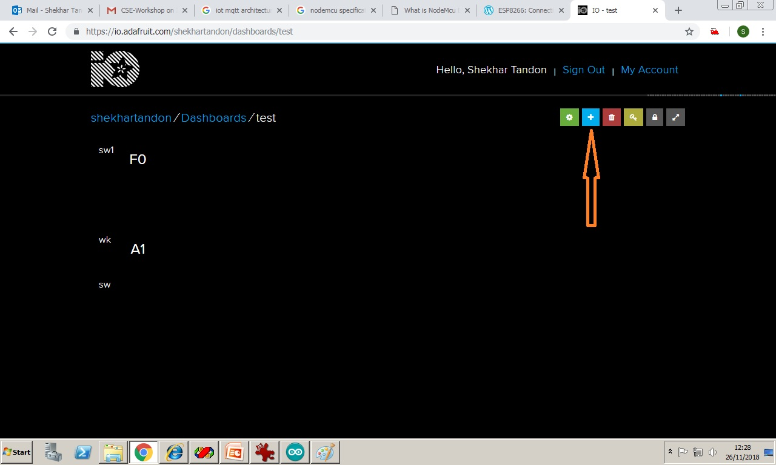
IoT Based Home Automation
Accounts on io.adafruit.com
Then Select the created Dashboard and press on the + button on right top corner

Slide 12
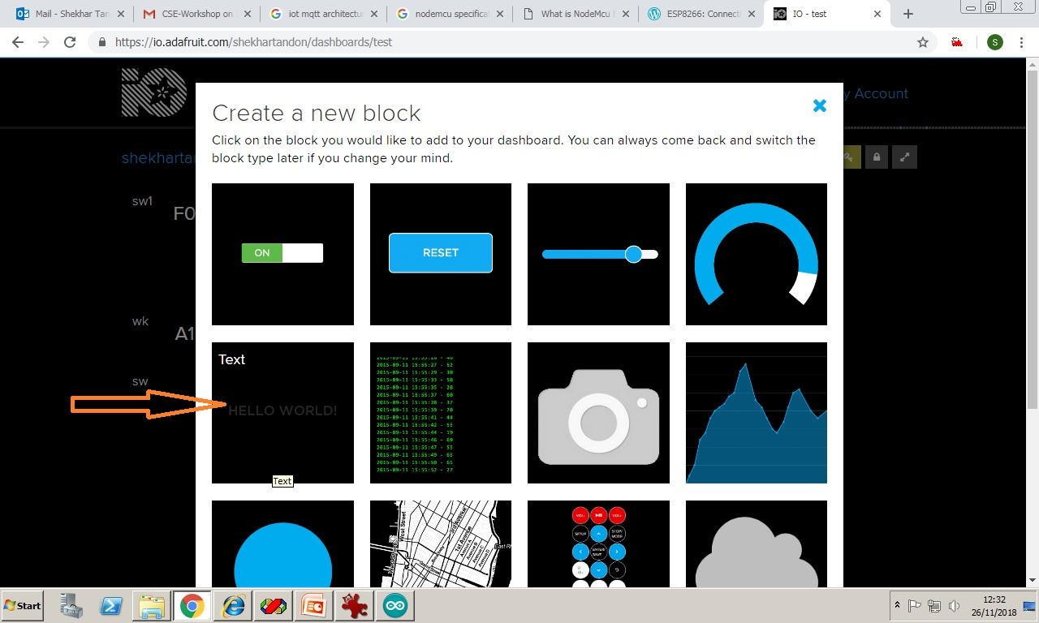
IoT Based Home Automation
This will ask to create a new block select text as in picture.

Slide 13
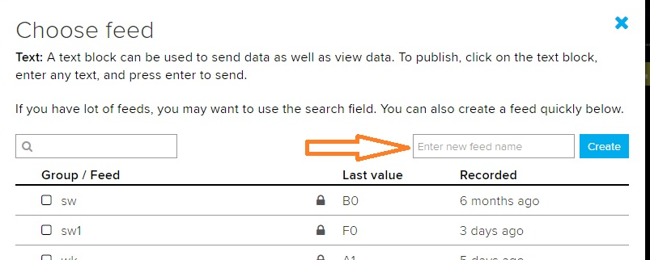
IoT Based Home Automation
After selecting Text block you have to create a feed of any name which will be used in program code to read data and perform action. Follow the on-screen commands then will be back on Dashboard Automatically.

Slide 14
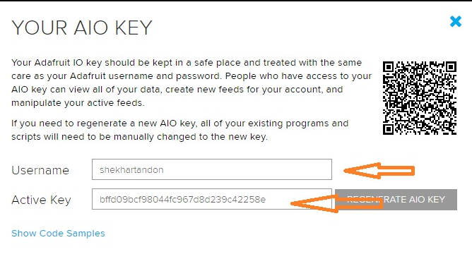
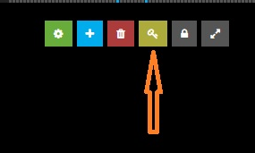
IoT Based Home Automation
Now from dashboard you can have your secret AIO key by clicking on key icon on right top corner.
Save the username and key. You will need this while programming the microcontroller. This ends the Broker setup using io.adafruit.com.

Slide 15
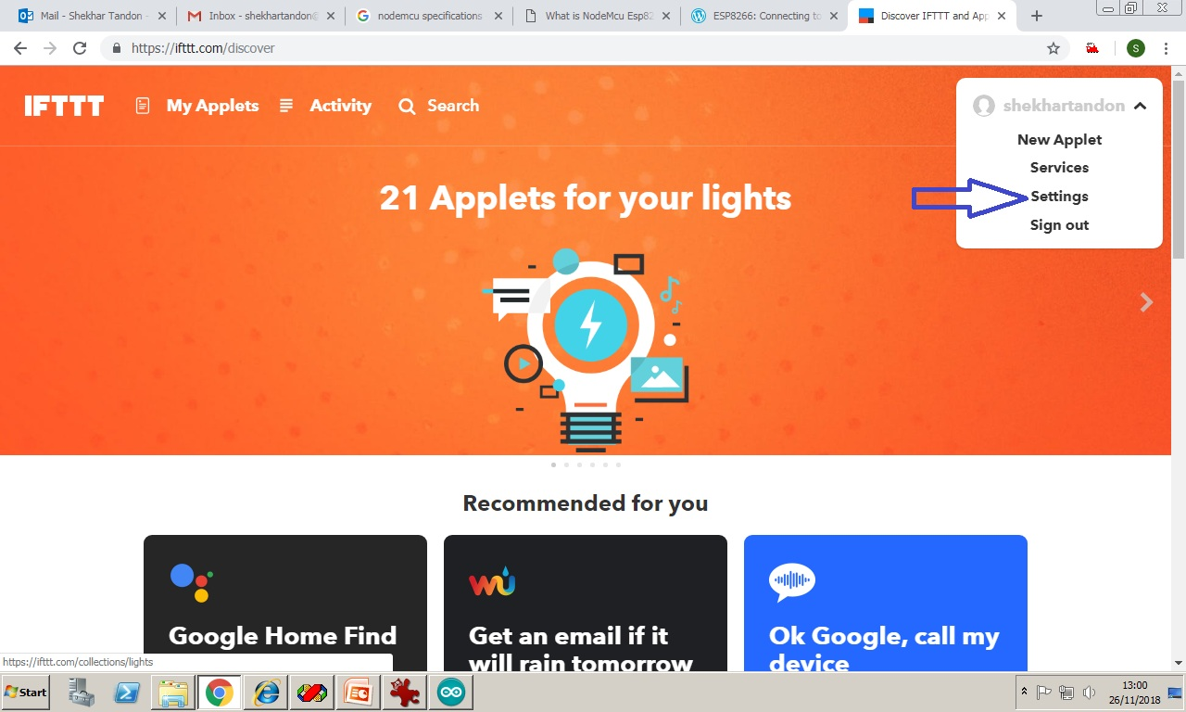
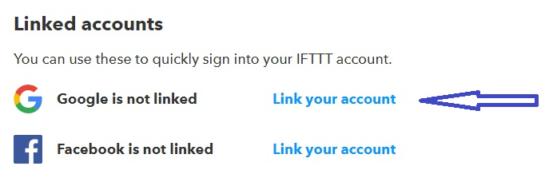
IoT Based Home Automation
Account on IFTTT.com is required to create your own applets to control you home appliances.
We shall use google assistant to control things.
1. First you are required to create your login on IFTTT.com , follow the on screen instructions and click on settings on right top corner.
In settings you need to link you google account in order to give command using google assistant

Slide 16
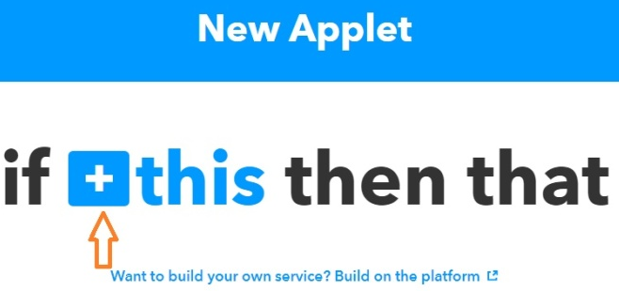
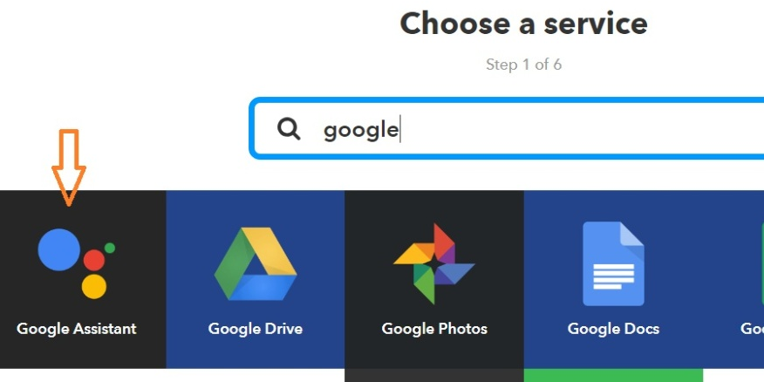
IoT Based Home Automation
After linking you google account you need to click on new applet button from main screen then click on + This sign. This will let you to select service.

Slide 17
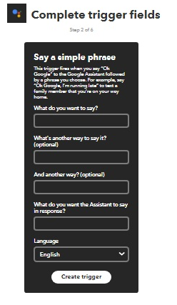
IoT Based Home Automation
Now you will be directed to initiate a trigger. You need to select the simple phrase. Now write down your command you want to say to google assistant. Such as you can write “Turn on Fan” in order to create the trigger. There are three options available for your command and one for response from google such as “OK Boss”

Slide 18
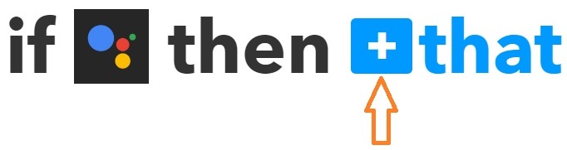
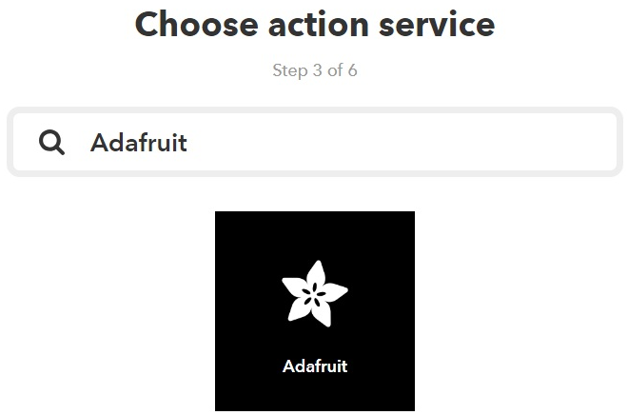
IoT Based Home Automation
Then IFTTT will redirect you to create action by pressing + THAT sign
This will allow to select Adafruit as service action

Slide 19
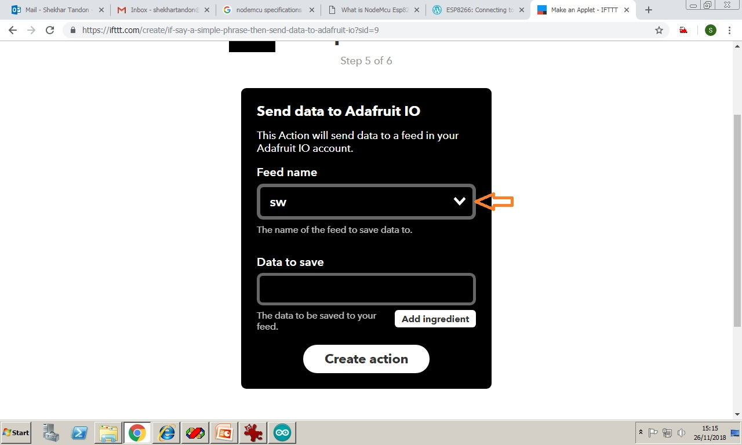
IoT Based Home Automation
Now provide your Adafruit credentials to have list of control BLOCKS created earlier in io.adafruit.com. You have to select feed name. This feed name will be used in programming code. You have to provide value under Data to save on the same window, which will also be checked in programming and depending upon this value microcontroller will perform action.

Slide 20
IoT Based Home Automation
Programming of Microcontroller
As previously told that NodeMCU is programmed using Arduino-IDE, therefore you need to install it on your computer.
After which open Arduino and navigate to
File->Preferences->Settings and write
http://arduino.esp8266.com/stable/package_esp8266com_index.json
in Board Manager Url

Slide 21
IoT Based Home Automation
Now navigate to Tools->Board Manager, search for ESP8266 and install it.
Next add Adafruit MQTT Library by navigating to Sketch->Include Library-> Manage Libraries
Then search for Adafruit_mqtt Library and install it.
Now connect the Microcontroller using USB cable and select NodeMCU1.0 with correct USB port (visible on bottom right corner of IDE).
This completes the initial setup for programming.

Slide 22
IoT Based Home Automation
Type the code and upload to the microcontroller
Points to be taken care before uploading-
Check SSID and PWD for your Home internet.
Check AIO Username and Key
Check feed name created on Dashboard of Adafruit.

Slide 23
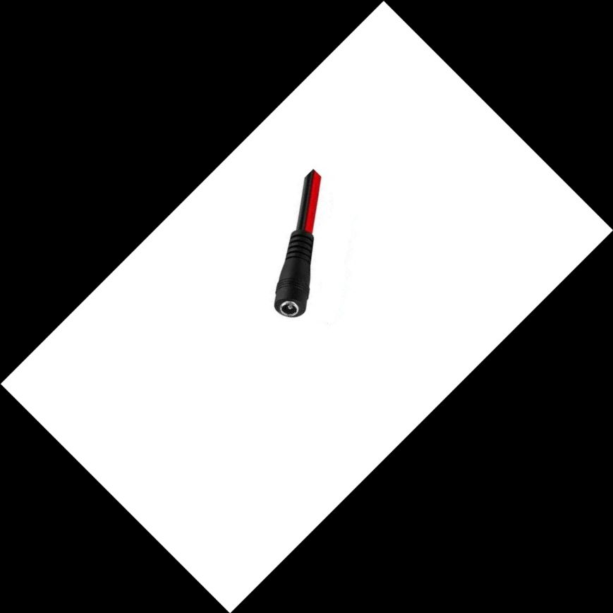
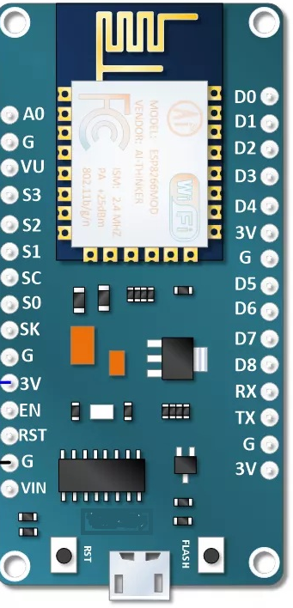
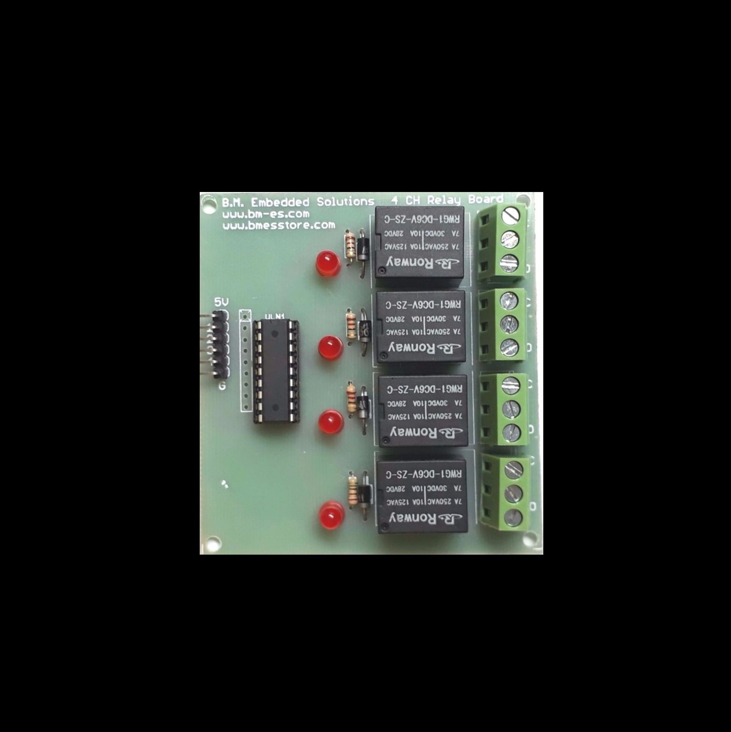
IoT Based Home Automation
Connection Diagram
5V Power
USB Port

Slide 24
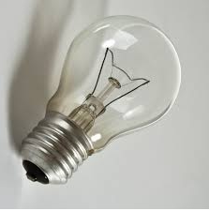
IoT Based Home Automation
Connection to Home Appliances
Two-way Switch
MAINS

